Slide 1
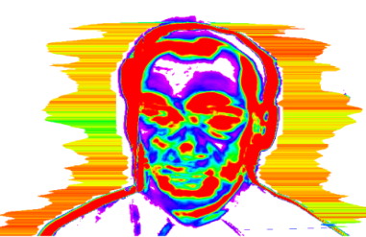
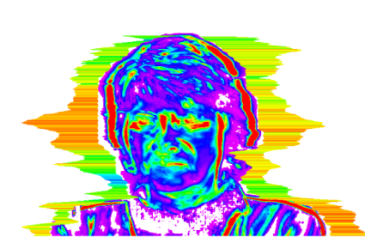
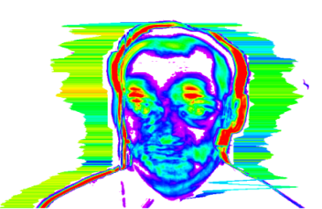
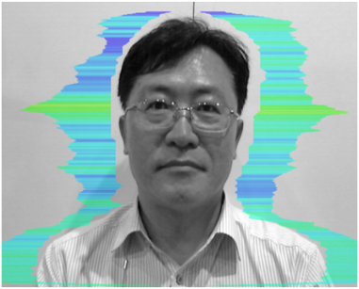
Video Polygraph Application
[Classic mode]
RESEARCH TO VERIFY AND UTILIZE PSYCHOPHYSIOLOGICAL DETECTION OF DECEPTION BASED ON VIBRAIMGE TECHNOLOGY.
2018 June
VIBRASYSTEM

Slide 2
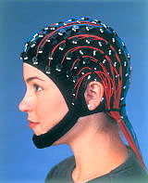
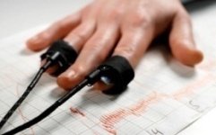
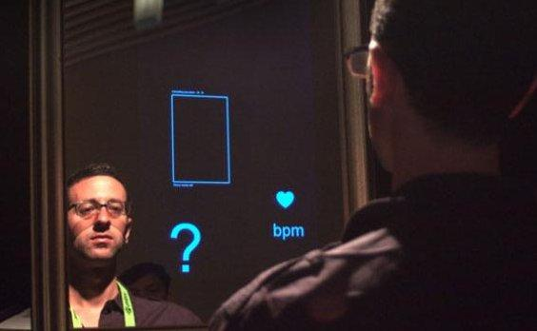
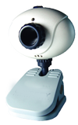
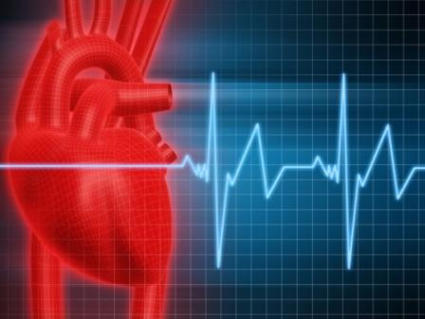
Why Video Polygraph system?
Contactless and Nonrestraint investigation
Vibra Image technology basis by using video image
100% Compatible process of Question and Answer with traditional Polygraph
system (Beckstar and Utah….)
Very short period for final judgment
- Much less rate in INC judgment to Contacting Polygraph system
VibraImage Technology basis
Civil
Liberty
Scientific
Investiga-
tion
Overcome limitation & Improvement
Revolutionary Polygraph
(Video Polygraph)
Bio-Signal
Contactless, Nonrestraint

Slide 3
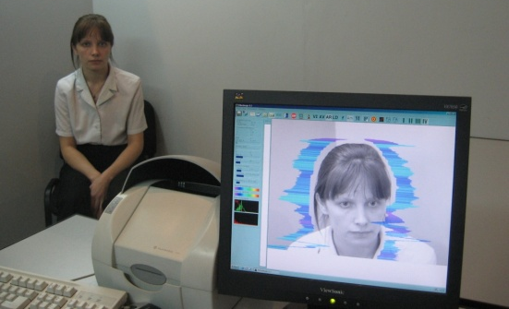
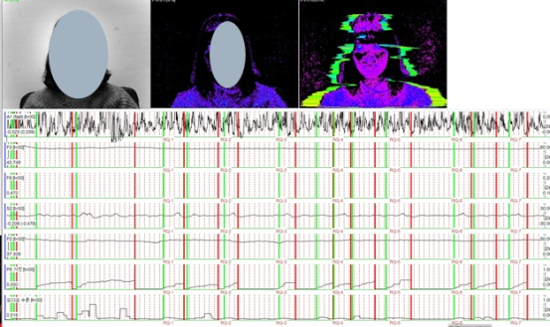
Overview of Video Polygraph
Video Polygraph Product
1. Video Polygraph- Classic
100% compatible process with traditionally contacting
polygraph (Accuracy rate : Up to 95%)
: No need to change the currently contacting polygraph
process with Beckstar, Utah…
Very quick judgment based on Vibraimage’s PDD data
To protect civil liberty and improve for scientific investigation
User friendly, Contactless, Nonrestraint and Economic system
To provide and analyze criminal’s psychology state (emotion)
Very high accuracy with much less ratio of INC
2. Video Polygraph- Interview
To indicate Probability of Lie during interview and statement
To deepen Pre-Test process before LD investigation
To select the key words to be questioned in LD process
To make investigation more efficient at the very early stage of
investigation by interview and statement to criminal
First Video Polygraph system for indicating Lie probability on
interview and statement
- User friendly, Contactless and Nonrestraint
Notes:
공격성 (P7) 스트레스 (P6) 긴장/불안 (F5X) 의심 (P19) 밸런스 (P16) 매력 (P17) 에너지 (P8) 자신감 (P18) 억제 (F6) 신경과민증 (F9)

Slide 4
Products
1. Video Polygraph program
1) Video Polygraph-Classic version
2) Video Polygraph-Interview version
* Program is sold individually by VIBRASYSTEM’s Licensing
2. Protections should be simultaneously taken for installation
and operation
1) USB Dongle : Elsys’s USB dongle
2) Software Licensing to Video Polygraph’s hardware system
3. Each operation manual
4. Hardware
- Video Polygraph Analyzer (Based on PC system)
- Camera
- Microphone
- Cables and others
5. Colored or White screen for background (Option)
Notes:
공격성 (P7) 스트레스 (P6) 긴장/불안 (F5X) 의심 (P19) 밸런스 (P16) 매력 (P17) 에너지 (P8) 자신감 (P18) 억제 (F6) 신경과민증 (F9)

Slide 5
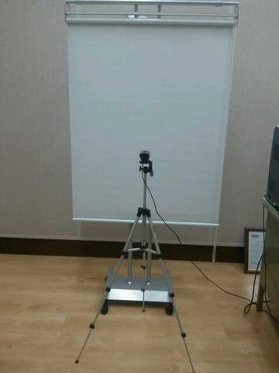
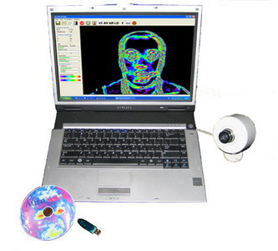
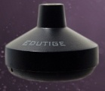
System Components
microphone
- Camera
(White screen)
- Others
Video Polygraph Analyzer
[Desktop PC recommended or NT PC]
+ Program installed
Notes:
공격성 (P7) 스트레스 (P6) 긴장/불안 (F5X) 의심 (P19) 밸런스 (P16) 매력 (P17) 에너지 (P8) 자신감 (P18) 억제 (F6) 신경과민증 (F9)

Slide 6
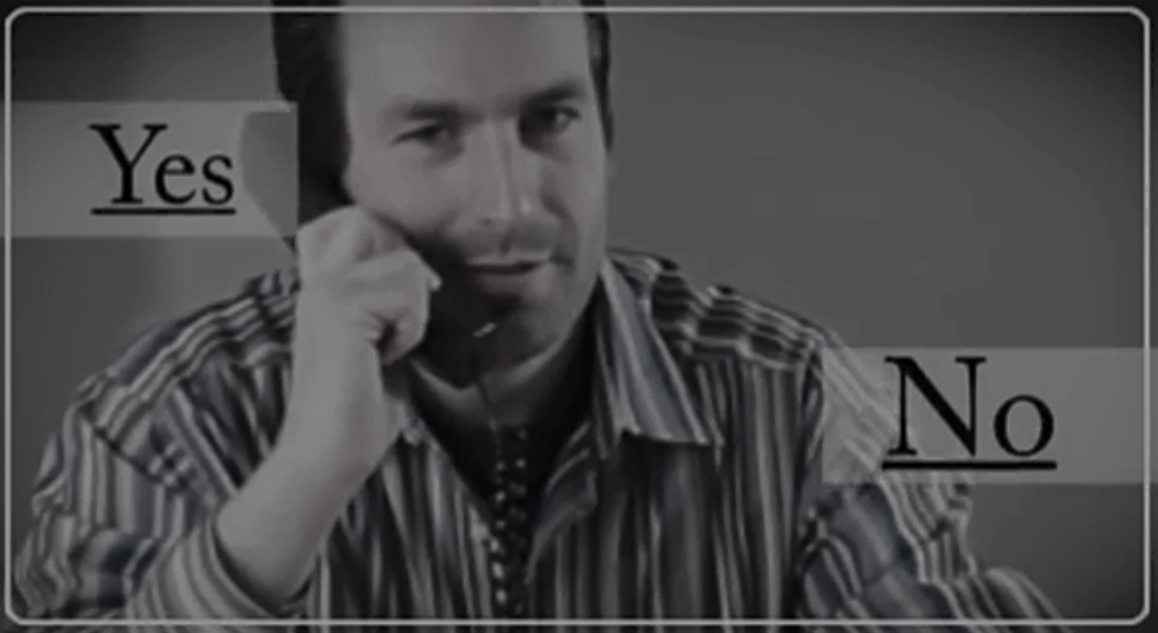
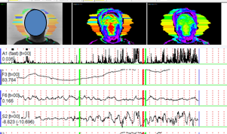
Video Polygraph – Classic
Video Polygraph – Classic system
:100% Compatible Q&A process
(Beckstar & Utah)
6

Slide 7
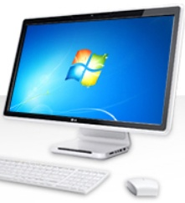
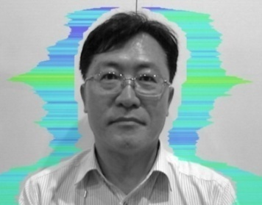
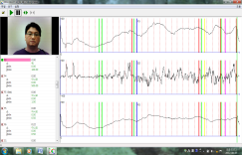
Product Overview
VIDEO POLYGRAPH
Program
operation
Criminal
camera
NDI /
DI /
INC
Capture video
image
1) CQ > RQ : True
2) CQ < RQ : Lie
3) CQ =~ RQ
: INC (Inconclusive)
Analysis
100% compatible process with the contacting Polygraph of Beckstar, Utah …

Slide 8
Question and Answer process
1) 100% compatible process
: 3CQ + 3RQ Questionaire
Start (OI,SQ)
GQ1
CQ1
RQ1
GQ2
CQ2
RQ2
GQ3
CQ3
RQ3
Finish
(CM)
2) 3 Cycle investigation
- PG#1,#2,#3 for every case
- If there is no 3 cycle’s video image file, can analyze the 2nd cycle’s
video image file
3) Can test by 2CQ + 2 RQ process
Notes:
공격성 (P7) 스트레스 (P6) 긴장/불안 (F5X) 의심 (P19) 밸런스 (P16) 매력 (P17) 에너지 (P8) 자신감 (P18) 억제 (F6) 신경과민증 (F9)

Slide 9
Testing mode
Audio mode :
Lie level calculation is performed when the input audio signal exceeds the threshold, and
stops when the audio signal level becomes less than the set threshold.
On graph at the start of data collection displays vertical green line, the time of completion –
a vertical red line.
This mode is recommended as the primary when working with a lie detector.
2) Manual mode :
Lie detection in the manual mode are usually used, if the quality of live or recorded sound is unsatisfactory and can not be on the level of sound to separate the questions and answers of the test person from outside noise.
Notes:
공격성 (P7) 스트레스 (P6) 긴장/불안 (F5X) 의심 (P19) 밸런스 (P16) 매력 (P17) 에너지 (P8) 자신감 (P18) 억제 (F6) 신경과민증 (F9)

Slide 10
Audio mode
Parameter
t
Level of sound
Audio Threshold
t
P5 Lie
Base
Stat
t
Notes:
공격성 (P7) 스트레스 (P6) 긴장/불안 (F5X) 의심 (P19) 밸런스 (P16) 매력 (P17) 에너지 (P8) 자신감 (P18) 억제 (F6) 신경과민증 (F9)

Slide 11
Manual mode
LD button
press
LD button
press
Parameter
t
P5 Lie
Base
Stat
t
Notes:
공격성 (P7) 스트레스 (P6) 긴장/불안 (F5X) 의심 (P19) 밸런스 (P16) 매력 (P17) 에너지 (P8) 자신감 (P18) 억제 (F6) 신경과민증 (F9)

Slide 12
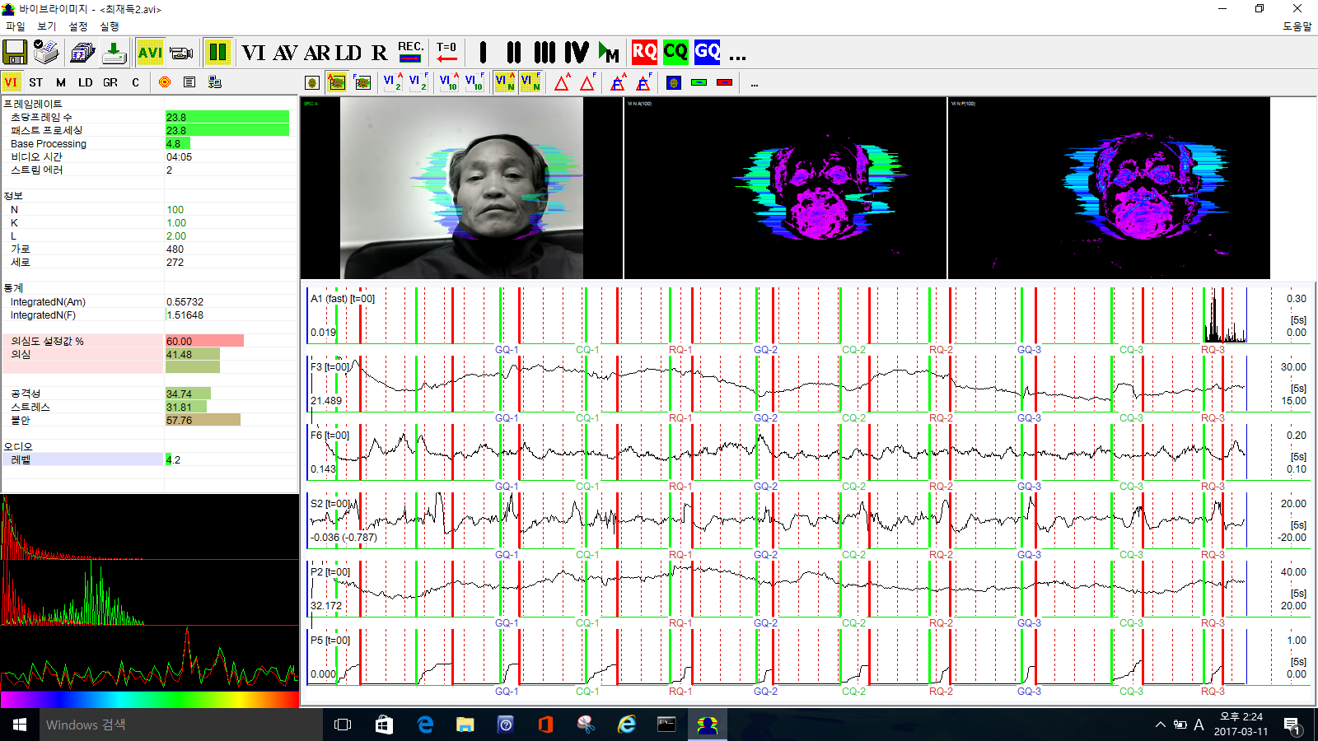
Testing sample – Audio mode
3 CQ + 3 RQ process
Result
True
(NDI)
Notes:
공격성 (P7) 스트레스 (P6) 긴장/불안 (F5X) 의심 (P19) 밸런스 (P16) 매력 (P17) 에너지 (P8) 자신감 (P18) 억제 (F6) 신경과민증 (F9)

Slide 13
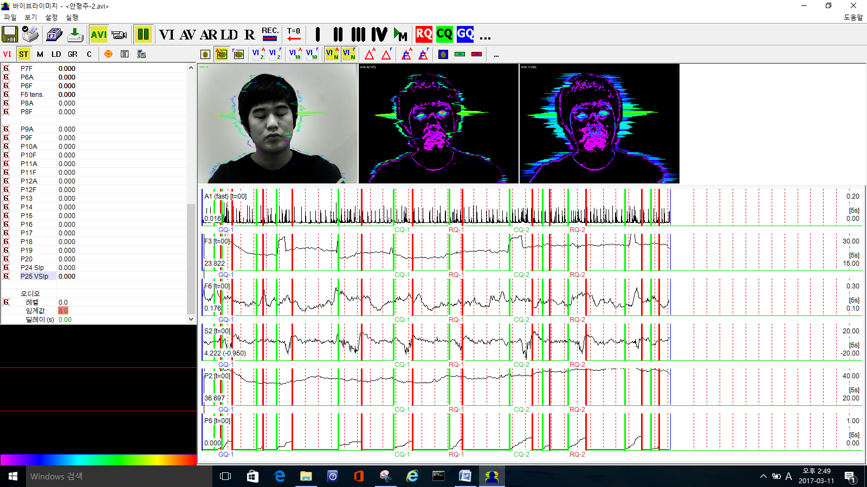
Testing sample – Manual mode
2 CQ + 2 RQ
Lie
(DI)
Notes:
공격성 (P7) 스트레스 (P6) 긴장/불안 (F5X) 의심 (P19) 밸런스 (P16) 매력 (P17) 에너지 (P8) 자신감 (P18) 억제 (F6) 신경과민증 (F9)

Slide 14
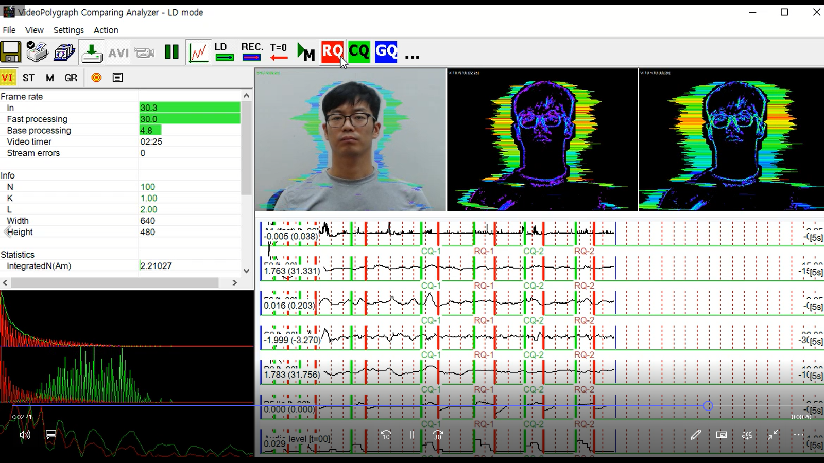
Testing sample : Sexual case
Notes:
공격성 (P7) 스트레스 (P6) 긴장/불안 (F5X) 의심 (P19) 밸런스 (P16) 매력 (P17) 에너지 (P8) 자신감 (P18) 억제 (F6) 신경과민증 (F9)

Slide 15
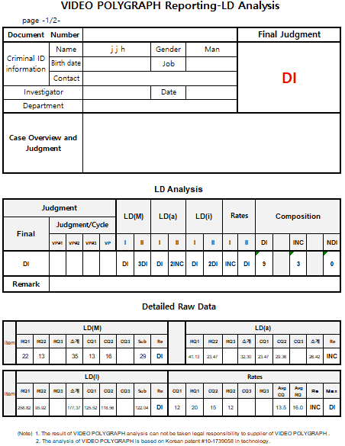
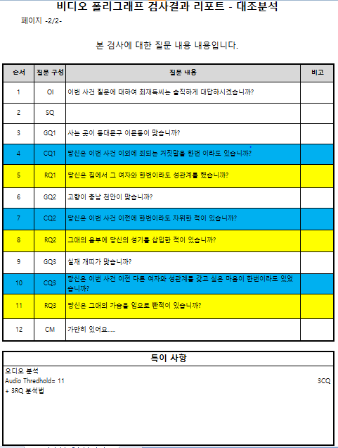
Report sample by Video Polygraph
Notes:
공격성 (P7) 스트레스 (P6) 긴장/불안 (F5X) 의심 (P19) 밸런스 (P16) 매력 (P17) 에너지 (P8) 자신감 (P18) 억제 (F6) 신경과민증 (F9)

Slide 16
World First VIDEO POLYGRAPH
Based on Vibraimage Technology
E-mail; kwan.choi@vibrasystem.co.kr
Mobile; +82-10 2305 6343

